Slide 1

New SHIFT

Slide 2
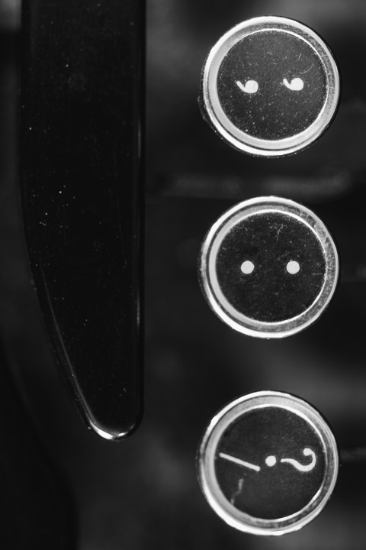
Current horizontal
(repeat use of ? Key)

Slide 3

Suggested new horizontal

